Slide 1

Presentation on E-Commerce Website
Project Title : QuickPick - E-Commerce Website
Team Members –
1. Gauri Sawant
2. Meghana Deshpande

Slide 2
Company Details
Tayan Solutions - TayanS is a leading IT company specializing in providing innovative and comprehensive technology solutions to businesses across various industries.With a deep understanding of the rapidly evolving digital landscape, we offer a wide range of services designed to help our clients leverage technology for growth and success. Our dedicated team of experts combines technical expertise with strategic thinking to deliver tailor-made solutions that drive efficiency, productivity, and competitive advantage.

Slide 3
What We Learn Through OJT
Strengthened our skills in HTML5, CSS, JavaScript through hands-on project work and daily tasks
Built basic navigation and footer like Zomato
Snapdeal Clone
Installation of Git and push files on GitHub
Snapdeal website clone creation
Enhanced skills in debugging, code structuring, and UI consistency
Experienced the complete workflow of a frontend project — from planning to publishing

Slide 4
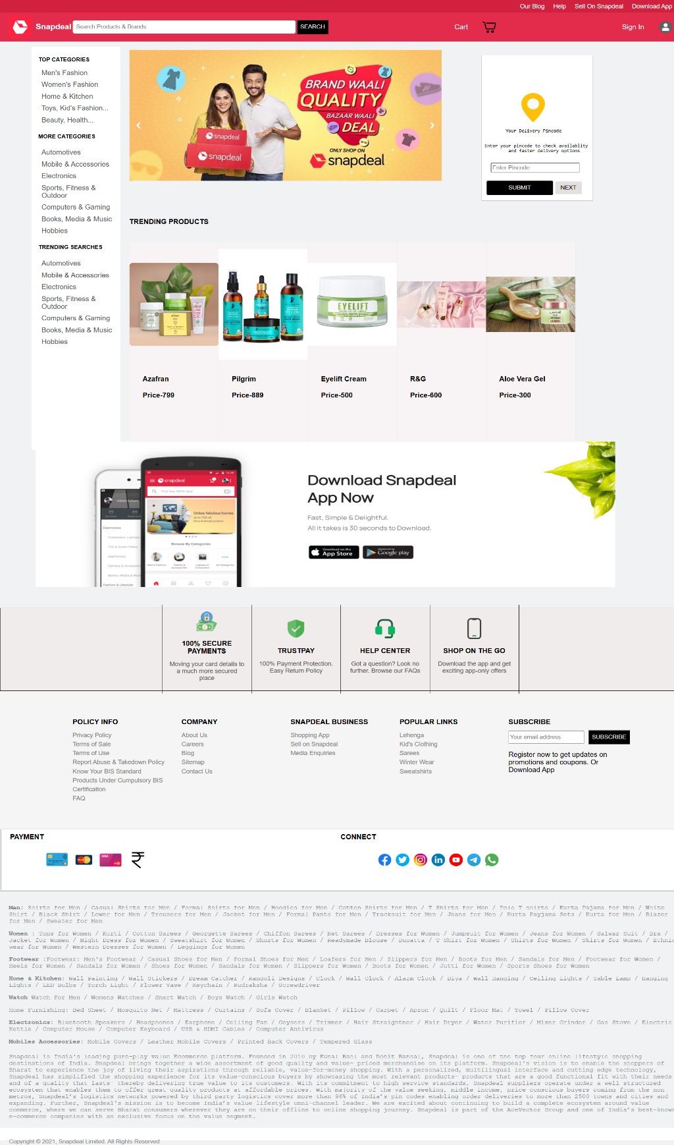
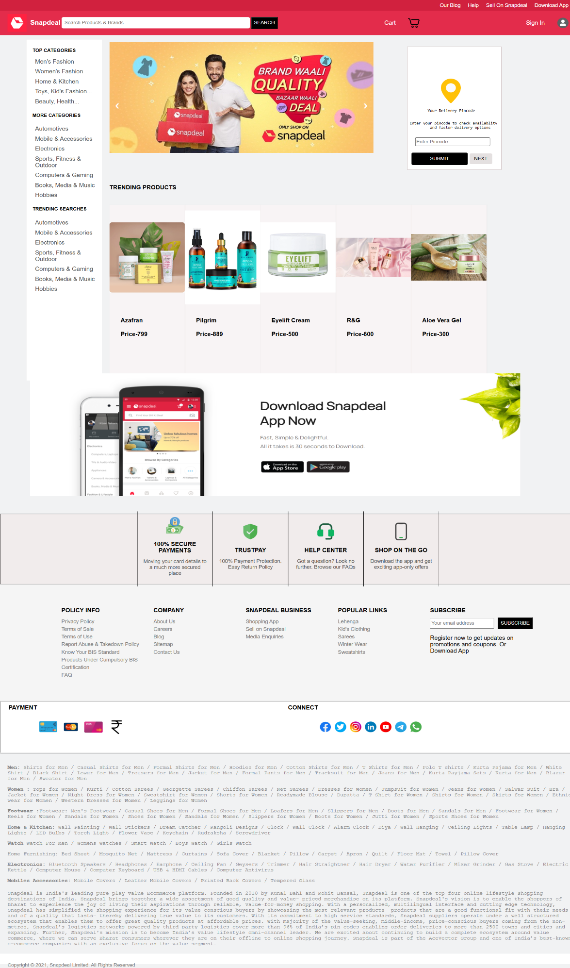
Snapdeal Clone

Slide 5
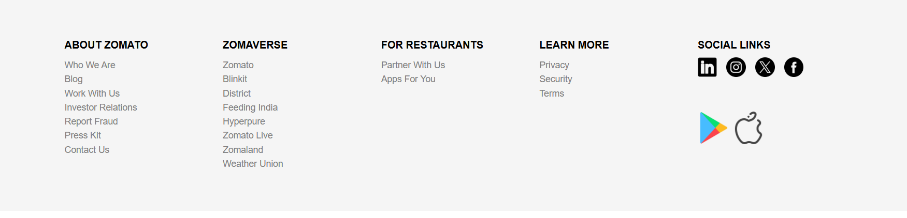
Zomato Footer -

Slide 6
QuickPick - E-Commerce Website
Introduction :-
QuickPick is a front-end e-commerce website developed using HTML, CSS, Bootstrap, and JavaScript. It offers users a modern online shopping experience with features like product browsing, category filtering, cart management, and a contact page. This project provided hands-on experience in developing responsive interfaces and implementing interactive website functionalities.
Purpose:-
The main purpose of QuickPick is to simulate a real online store while helping developers practice and apply core web development concepts. It focuses on building a user-friendly, responsive interface without the complexity of databases or user authentication. The project aims to improve understanding of how e-commerce platforms work and enhance front-end development skills.

Slide 7
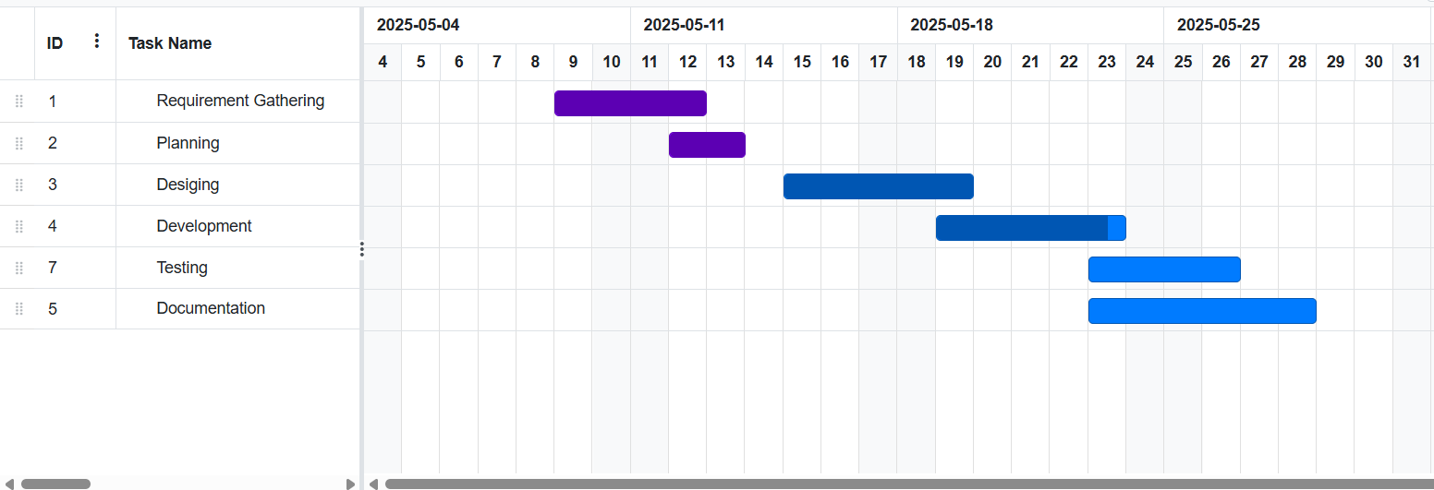
Roles and Timeline
Development –Gauri Sawant, Meghana Deshpande

Slide 8
Development
Development refers to the phase where the actual coding and functionality of the website are implemented.
This involves converting design mockups into working web pages and integrating features that allow users to interact with the site effectively
Technologies & Tools Used –
1. HTML, CSS, JS – For building the structure, styling, and interactivity of the website.
2. VS Code – To write, edit, and manage the project code efficiently.
3. GitHub – For version control and collaboration among team members.

Slide 9
Step By Step Implementation
We implemented category-based filtering with price range options across all three categories (Men, Women, Electronics).
In a women category it Displays a variety of women’s clothing and accessories includes category filters like Tops, Dresses, and Shoes
Filter by Category & Price
Sidebar contains:
Category filter (e.g., T-shirts, Jeans, Shoes, etc.)
Price range filter (₹0 to ₹2000)
Filters are implemented using JavaScript.
Product details (name, price, description, image, rating) are loaded dynamically using JavaScript based on the product id from the URL.
Related Products Section
Displays related products dynamically using a predefined JavaScript array.
Each related product has an image, name, price, and a “View Details” button that links to its details page.

Slide 10
Size Selection
Users can select a product size (S, M, L, XL, XXL).
Selected size is visually highlighted using DOM manipulation.
Quantity Selector
Allows users to increment/decrement product quantity before adding to the cart.
Add to Cart Functionality
On clicking "Add to Cart":
Checks for selected size and quantity.
Saves product to localStorage with full details.
If the product with the same size exists, updates the quantity instead of duplicating.

Slide 11
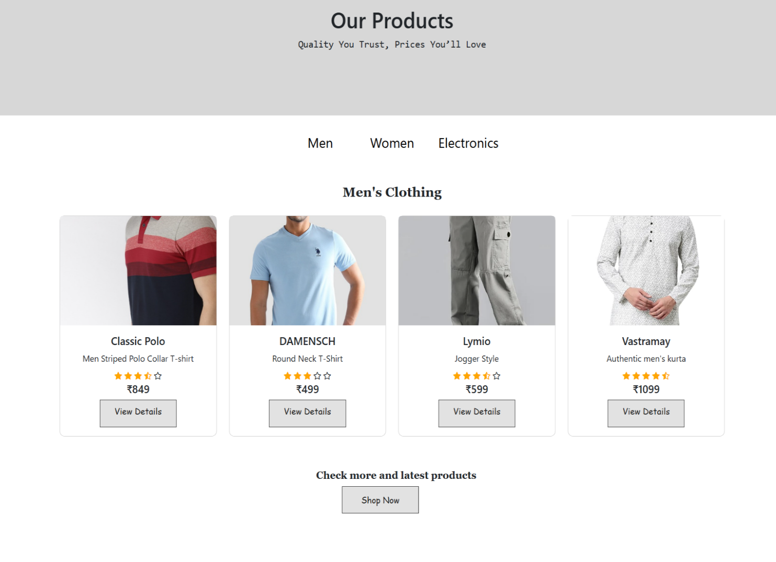
Product Listing Page
Category-based filtering with price range options across all three categories (Men, Women, Electronics).

Slide 12
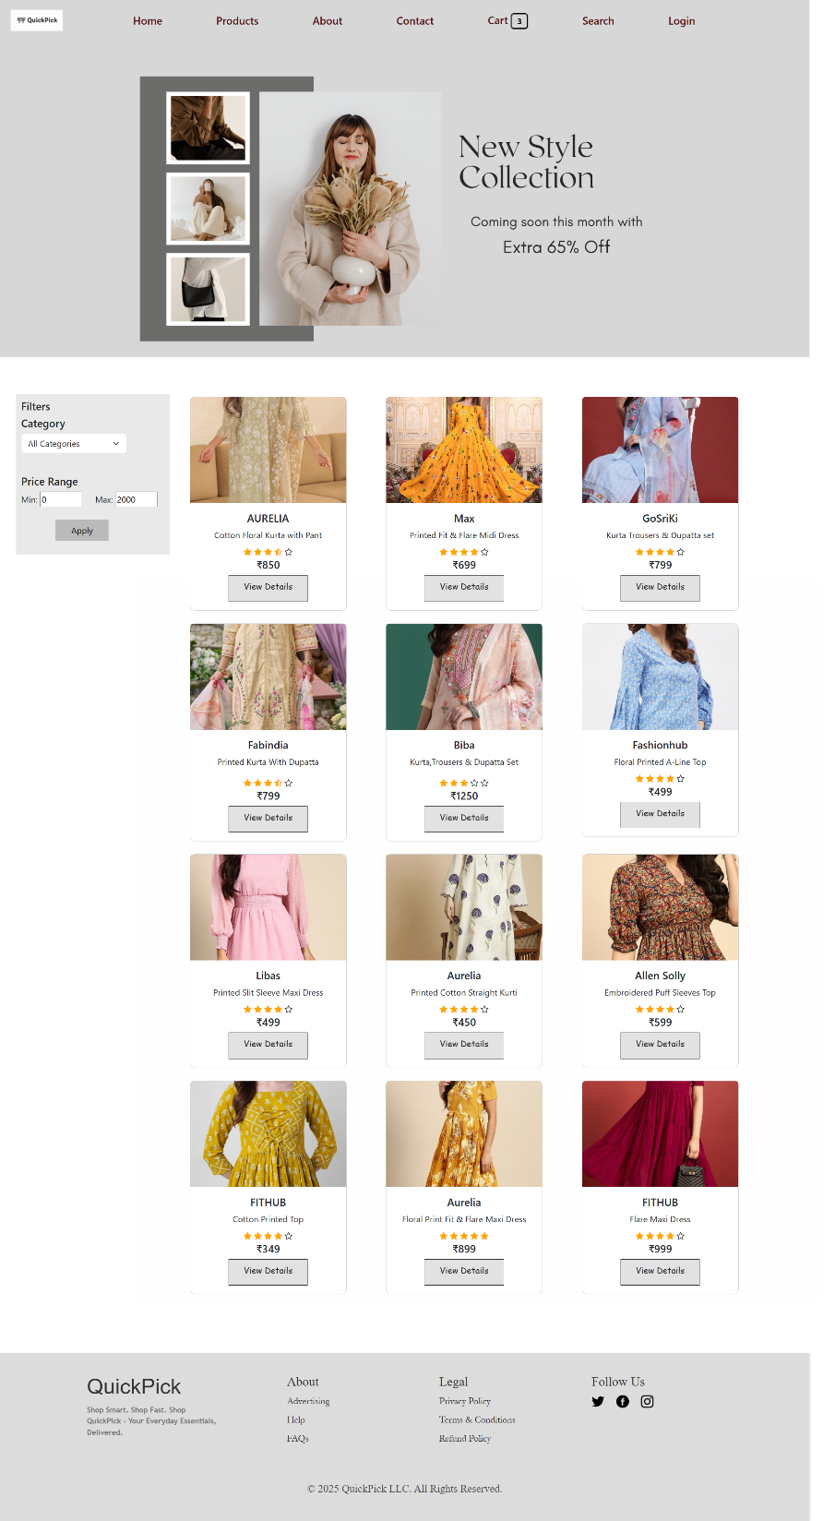
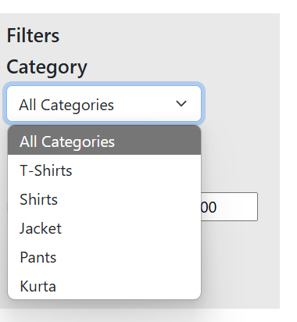
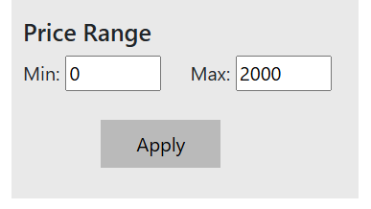
Women’s Clothing Page
Category-Based Filtering
Price Range filter

Slide 13
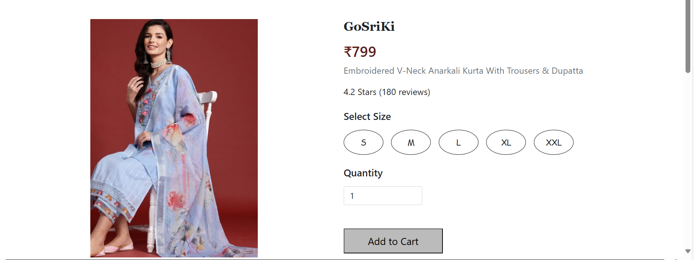
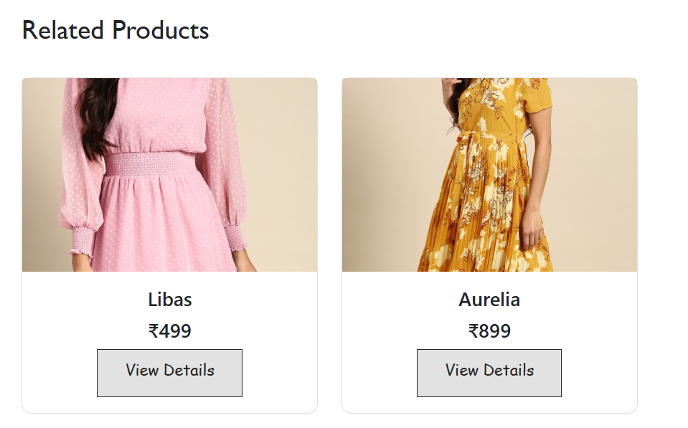
Product View Details
Adjust Quantity for each
product also Select size option
Shows similar products based
on a pre-defined list

Slide 14
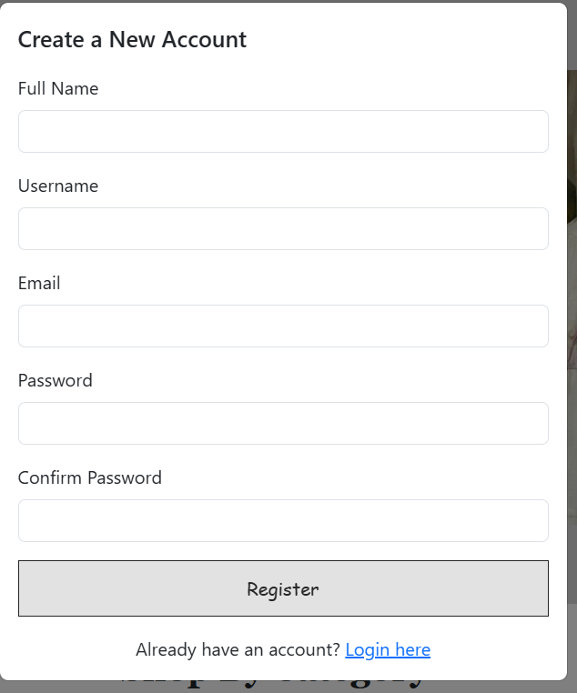
Authentication System
Registration Page
User sign-up with name, email, password.
Data stored in localStorage.

Slide 15
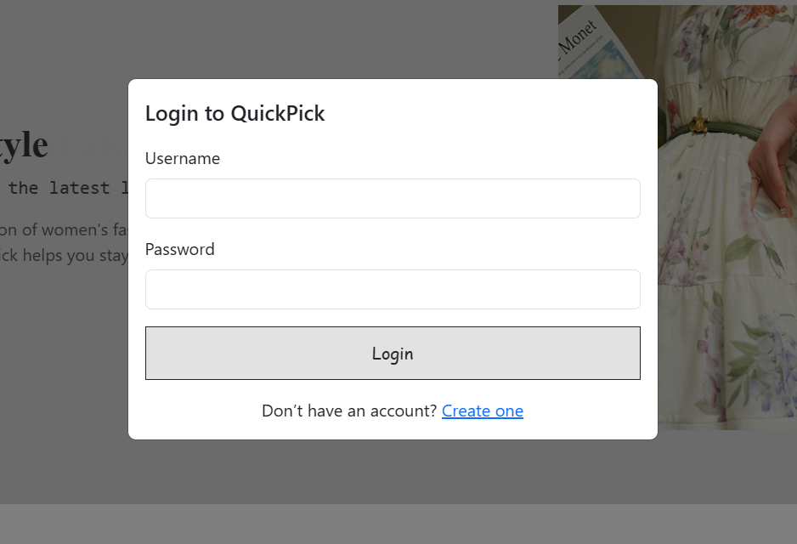
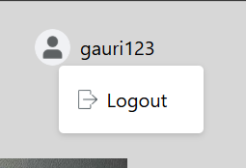
Login Page
Verifies credentials from localStorage.
Shows error/success messages.
Profile & Logout
Displays user username after login.
Clear user info

Slide 16
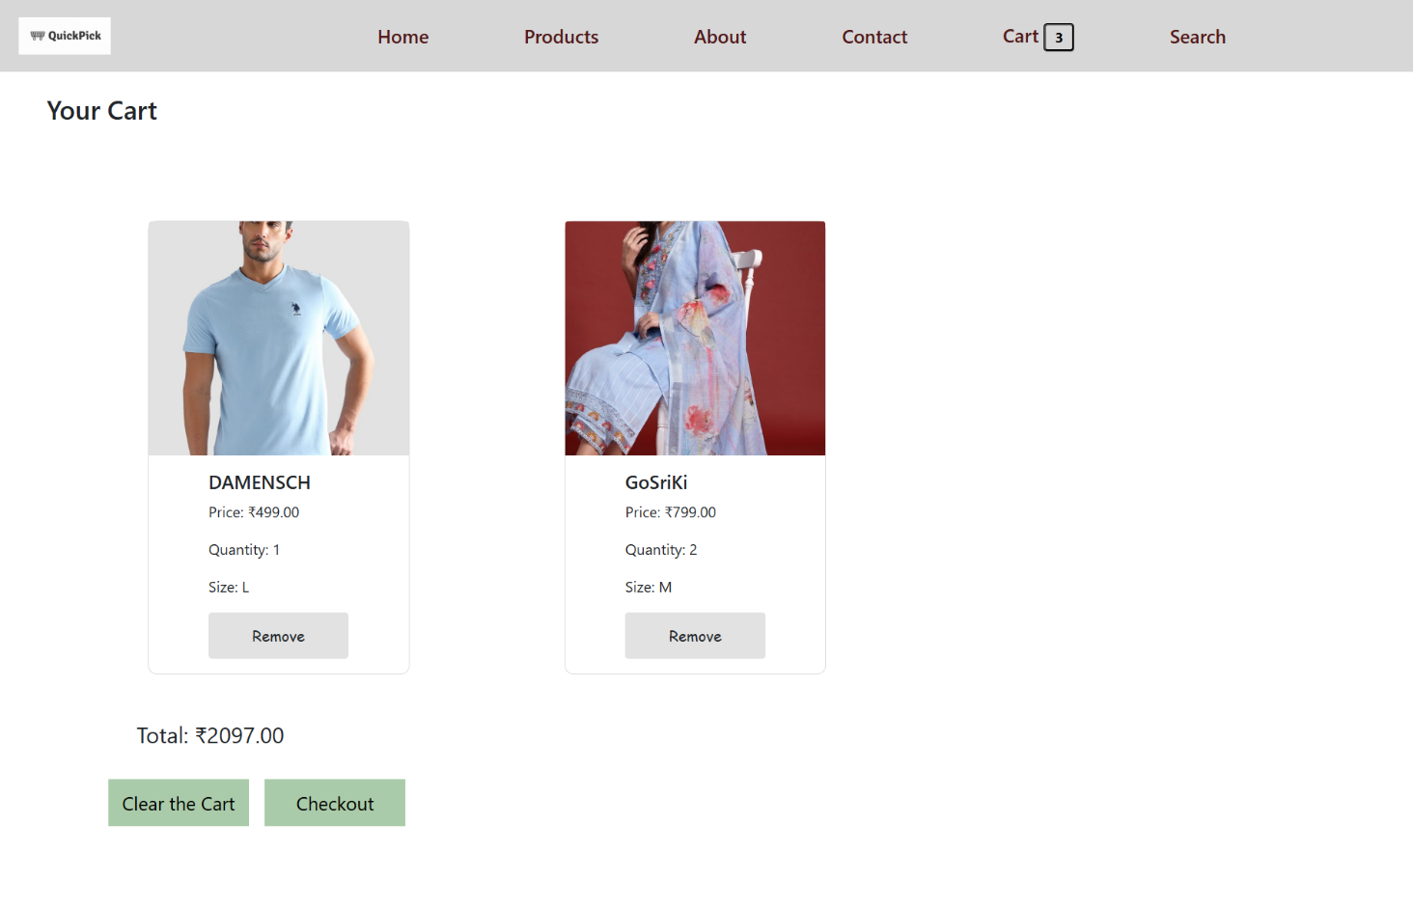
Shopping Functionality
Cart Page
View added items with details – name,quantity ,size,
Remove button to remove specific product
Clear button to clear the cart

Slide 17
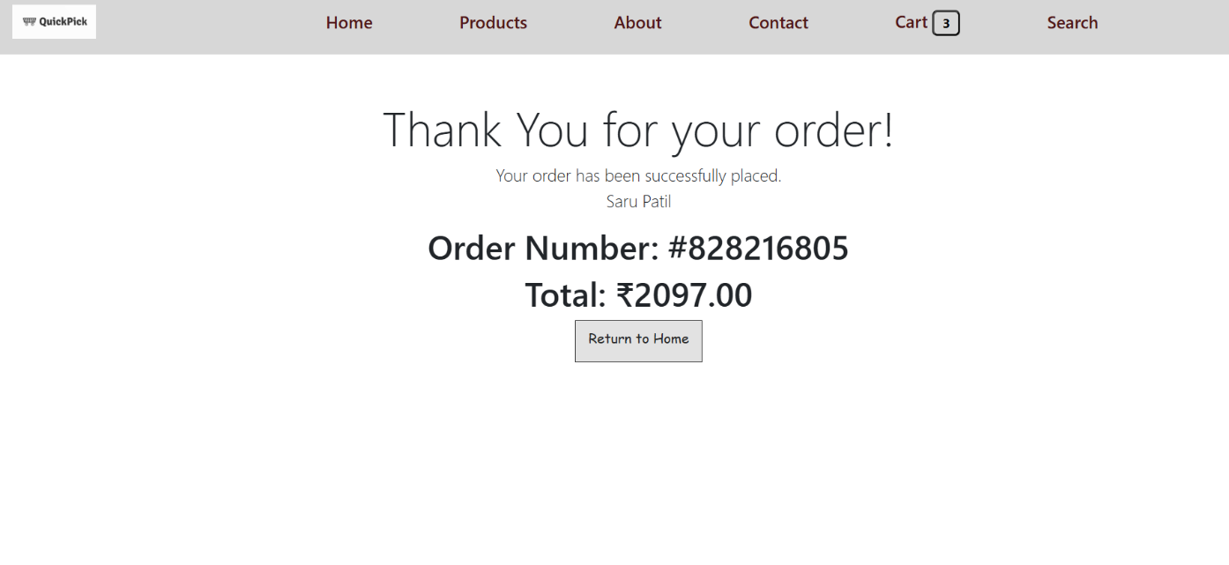
Checkout Form
Total price and checkout form
Validates all input fields and proceed to checkout.
Order Confirmation
Displays random order number after checkout.

Slide 18
Learning Outcomes
Mastered HTML, CSS, and JavaScript
Learned DOM manipulation and responsive design
Understood team collaboration and project workflow
Gained hands-on experience in real-world web development

Slide 19
Conclusion
QuickPick successfully meets all objectives, offering a fully functional e-commerce experience with modern UI and interactivity. We have improved our technical skills and developed confidence in building and presenting a complete web project. Future scope includes adding backend integration and payment gateway support.

Slide 20
Thank You!!

